Slide 1
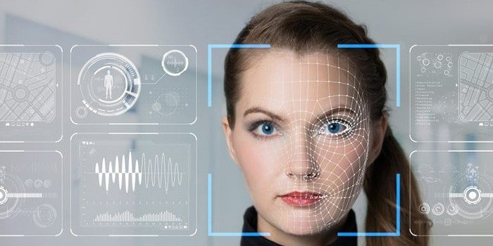
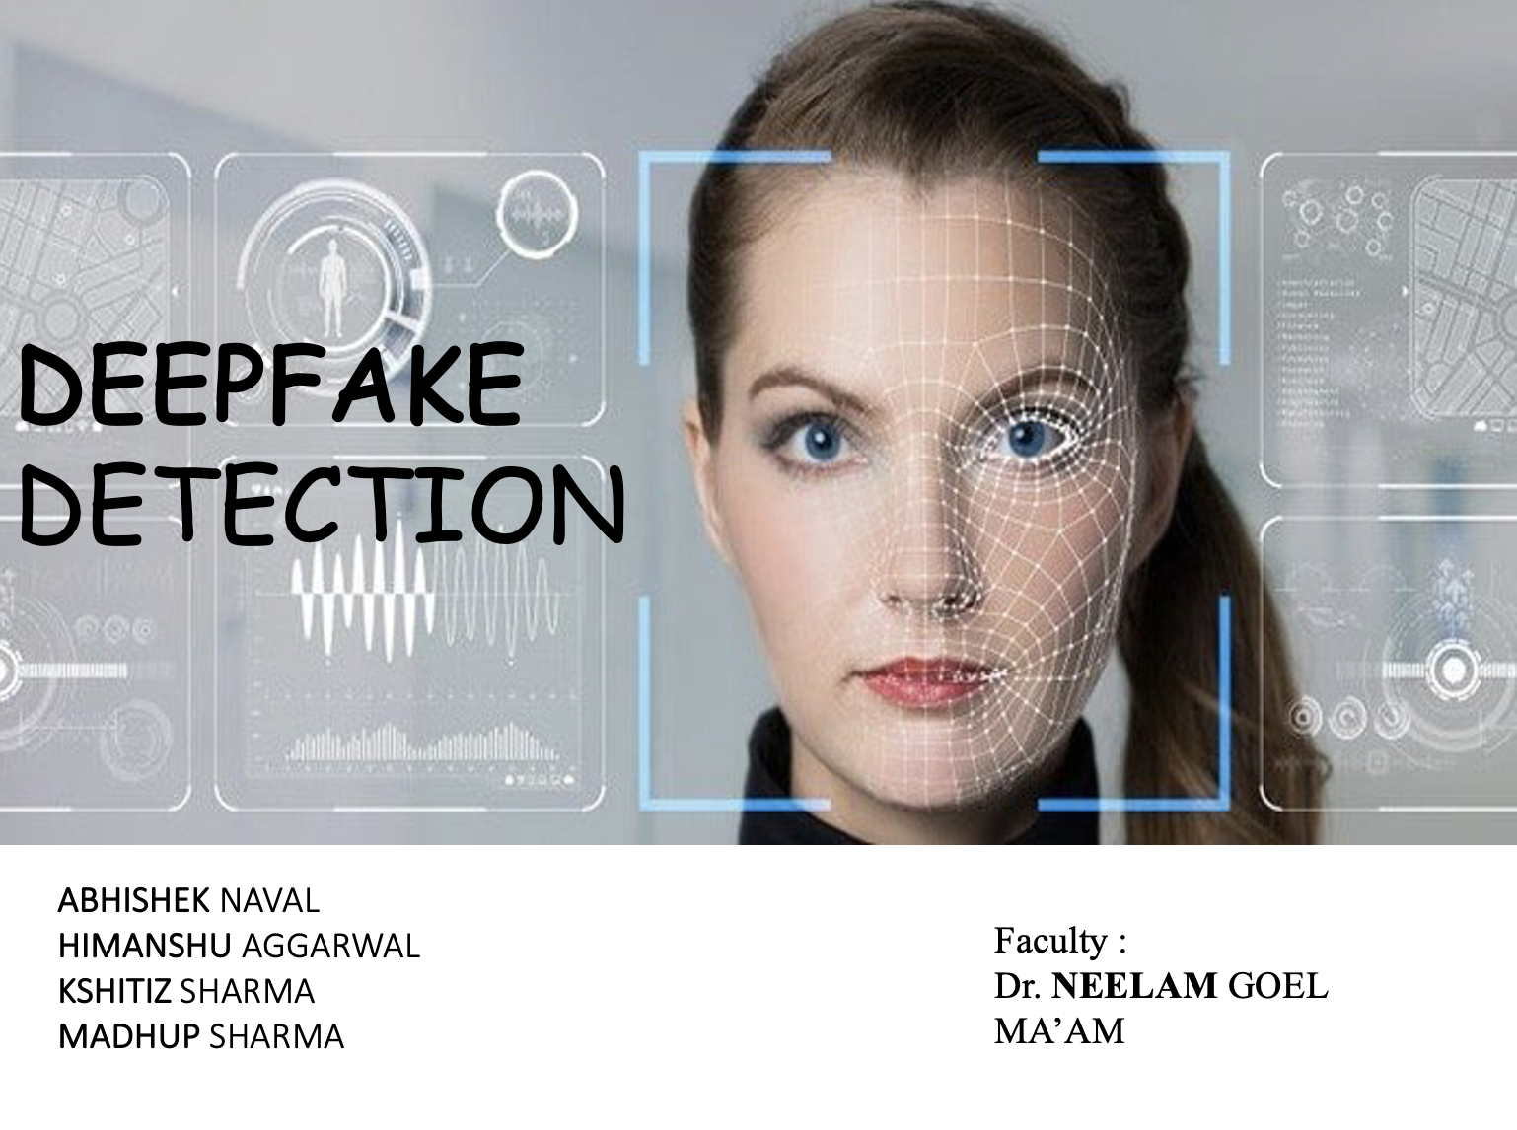
DEEPFAKE DETECTION
HIMANSHU AGGARWAL
MADHUP SHARMA
KSHITIZ SHARMA
ABHISHEK NAVAL
Faculty :
Dr. NEELAM GOEL MA’AM

Slide 2


Problem Statement
To Design and Develop a Deep Learning algorithm to classify the video as deepfake or pristine.

Slide 3
Introduction
Prediction Workflow
01
06
How Deepfake Created
07
Results
02
System Architecture
08
Tools and Technologies
03
Applications
04
Pre-Processing
09
Training Workflow
10
Future Plans
05

Slide 4
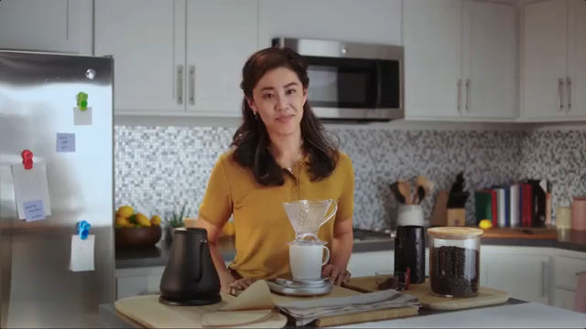
Introduction
Deep fake is a technique for human image synthesis based on artificial intelligence.
Deep fakes are created by combing and superimposing existing images and videos onto source images or videos using a deep learning technique known as generative adversarial network.

Slide 5
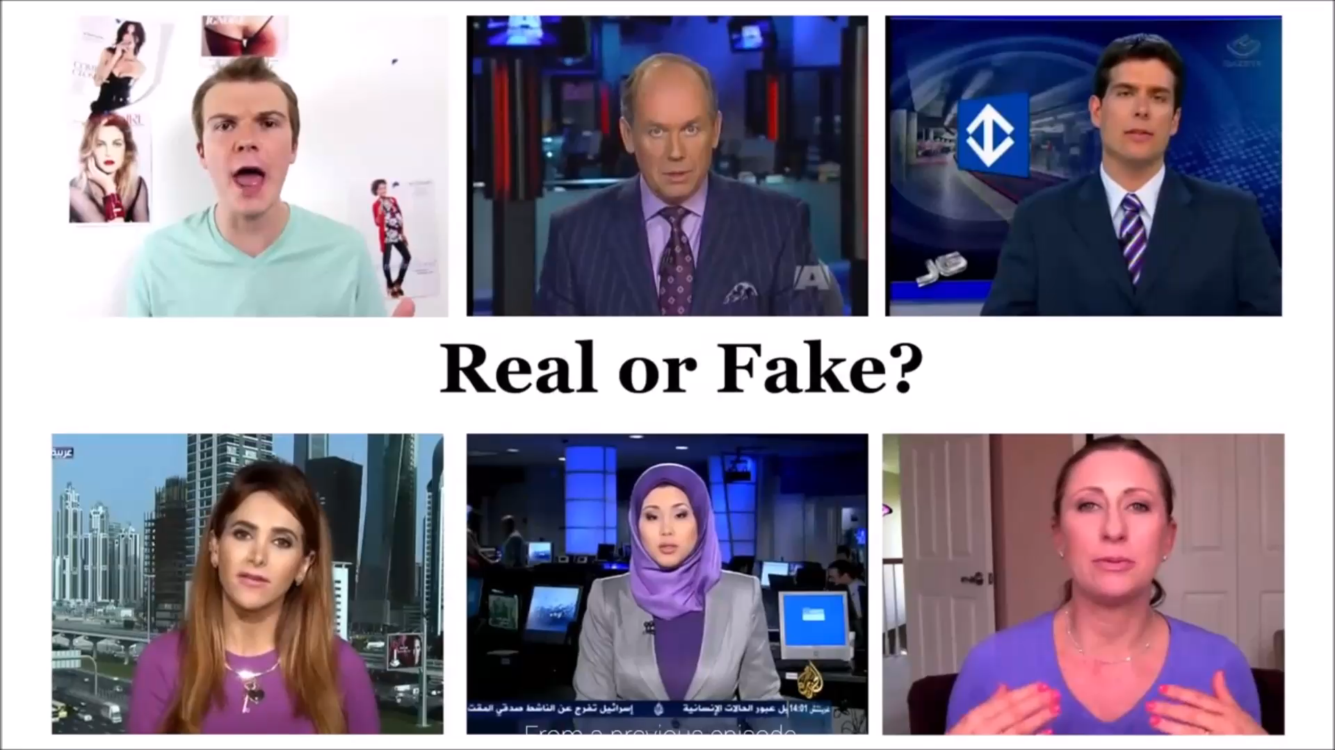

Slide 6
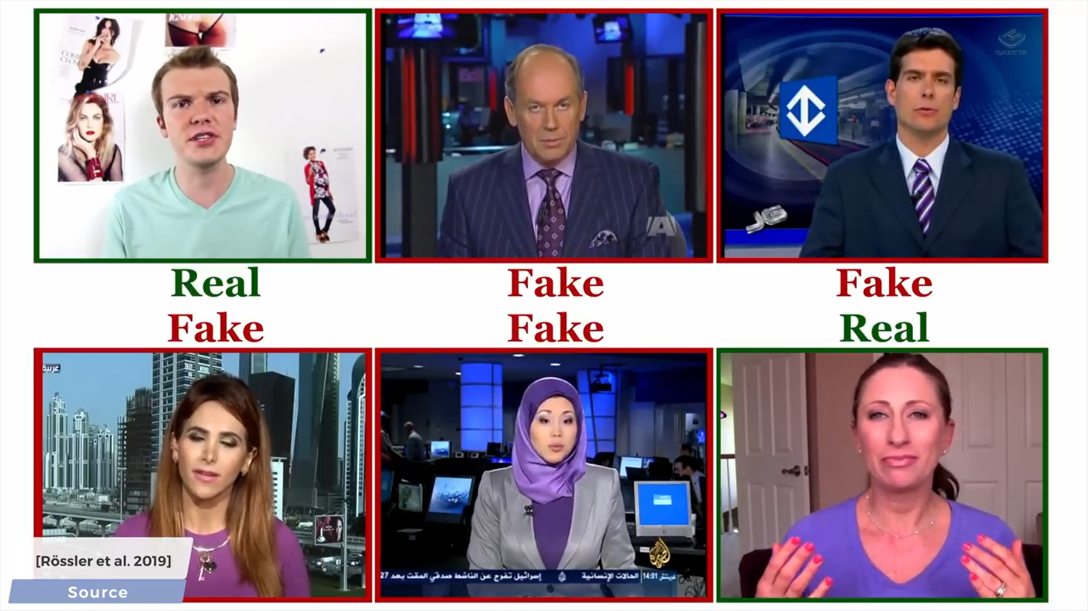

Slide 7
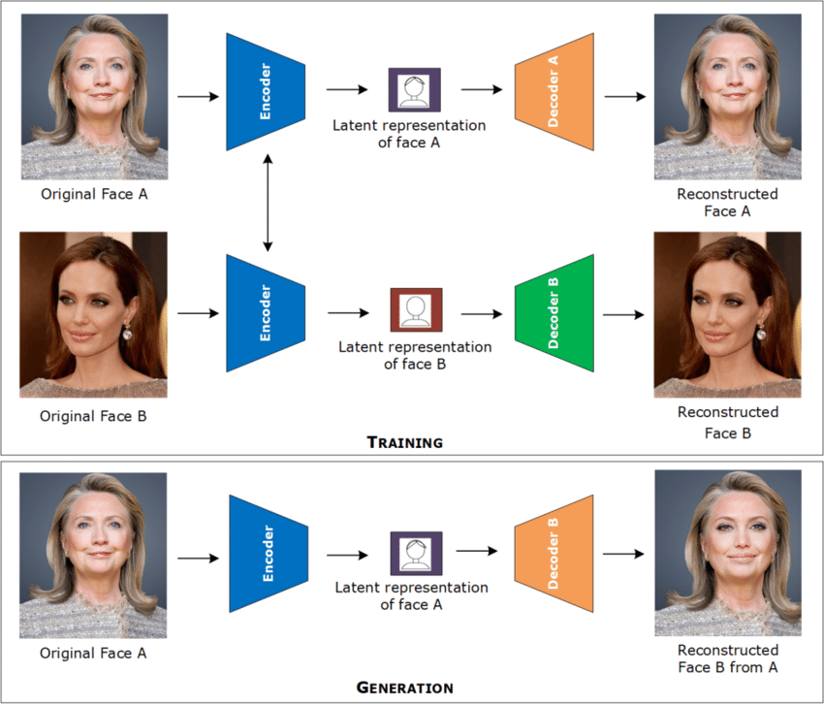
How Deep Fakes Are Created ?
Tools for deep fake creation.
Face swap
Faceit
Deep Face Lab
Deepfake Capsule GAN
Large resolution face masked

Slide 8
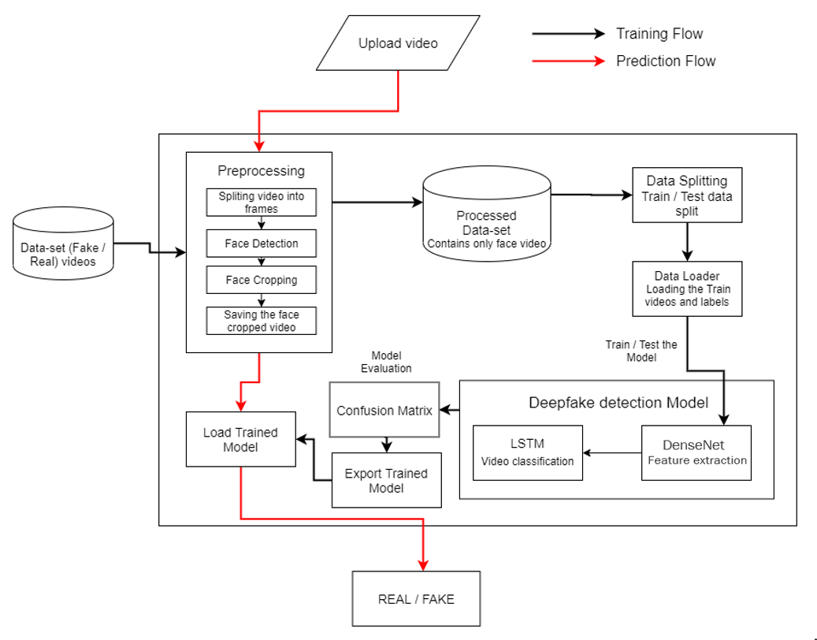

System Architecture

Slide 9
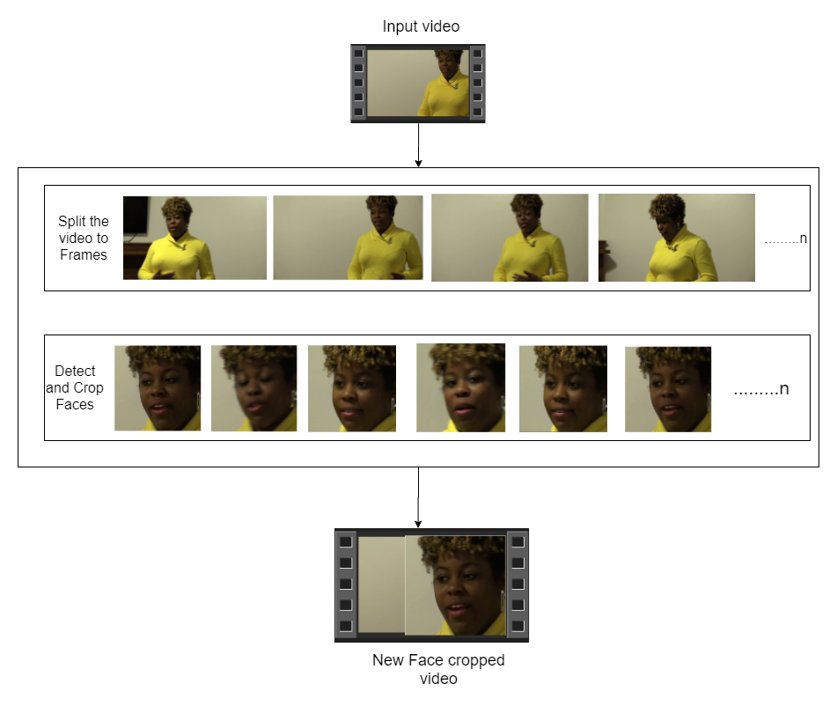

Pre-processing
SPLIT VIDEO INTO FRAMES
FACE DETECTION
5
4
3
2
1
CROPING FACE
CREATING NEW FACE CROPPED VIDEO
SAVING THE FACE CROPPED VIDEO

Slide 10
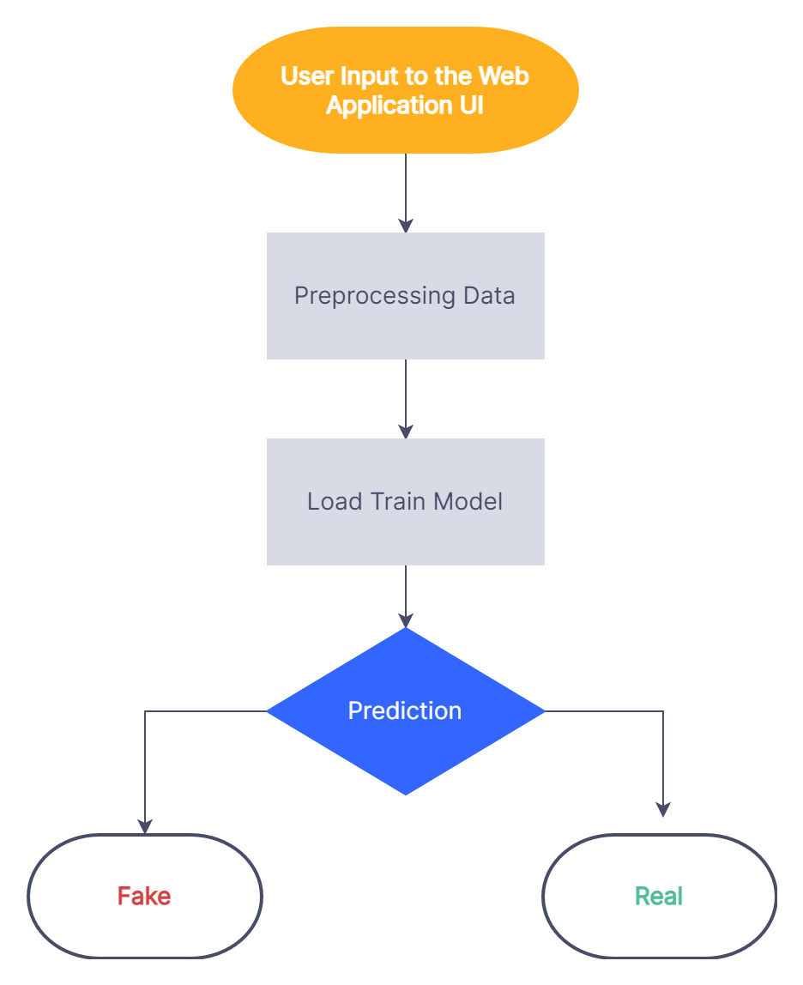
Prediction Workflow

Slide 11
Increased data set from 400 (350 fake 50 real) videos to 537 videos (297 fake 239 real )
Biased data set to unbiased dataset
Implemented and compared different model and there accuracy (VGG16 ResNext50 Densenet121)
Progress

Slide 12
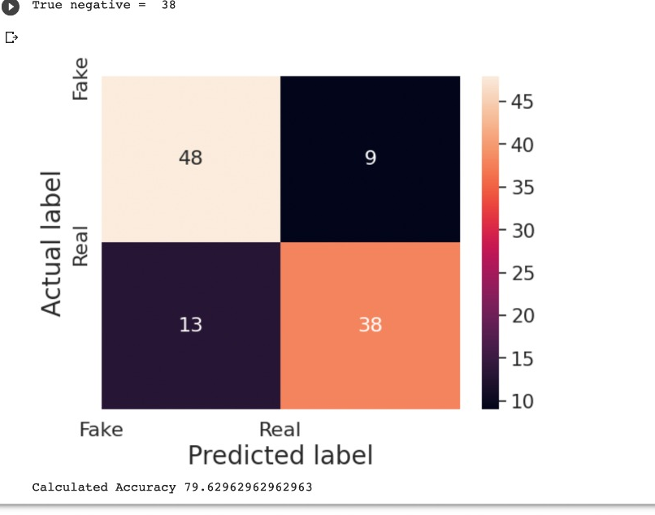
ResNext

Slide 13
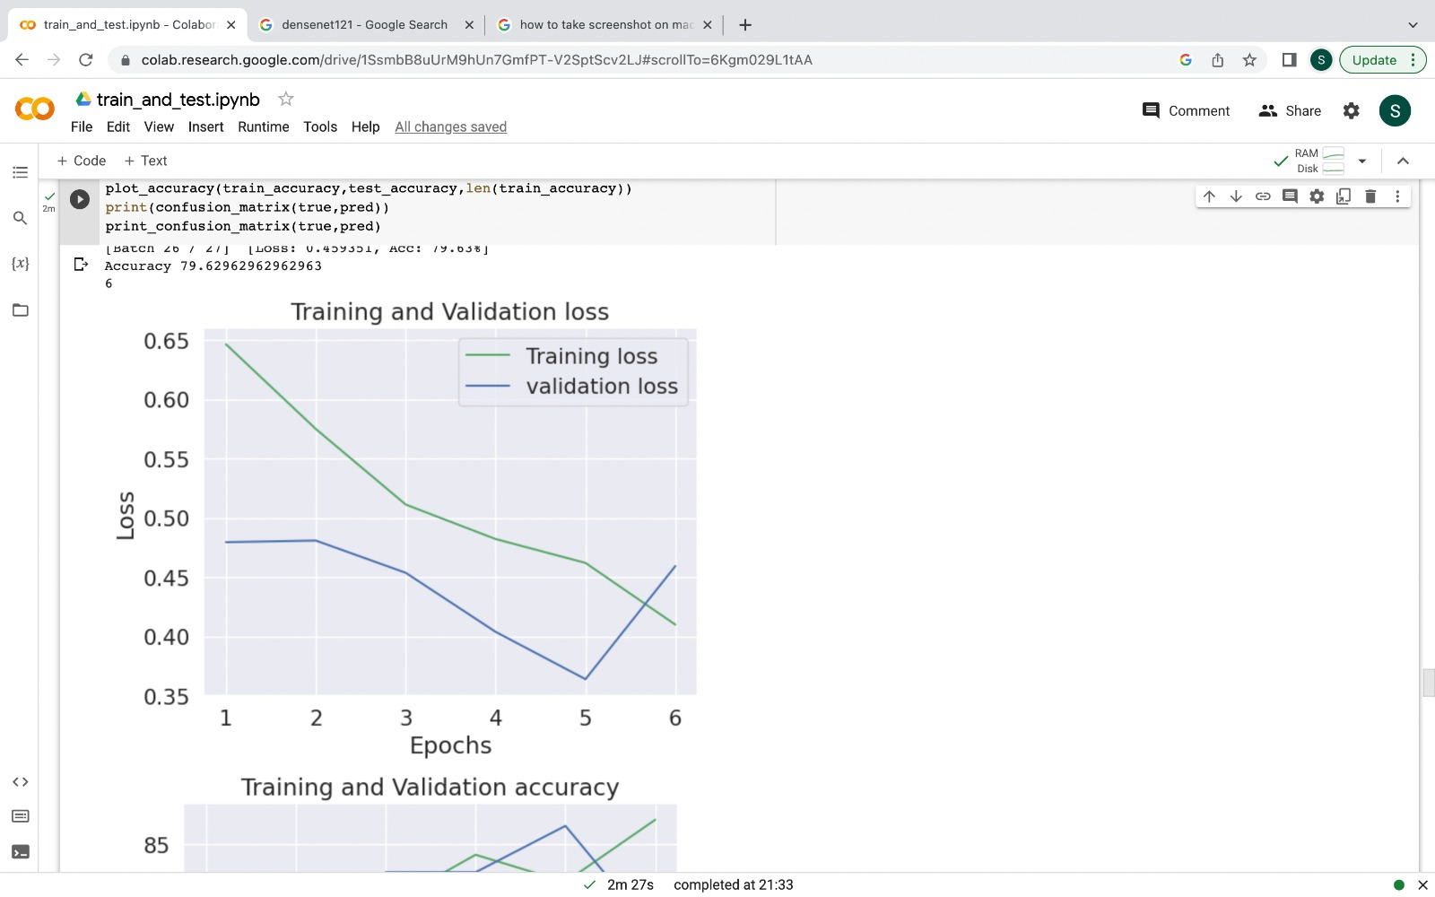
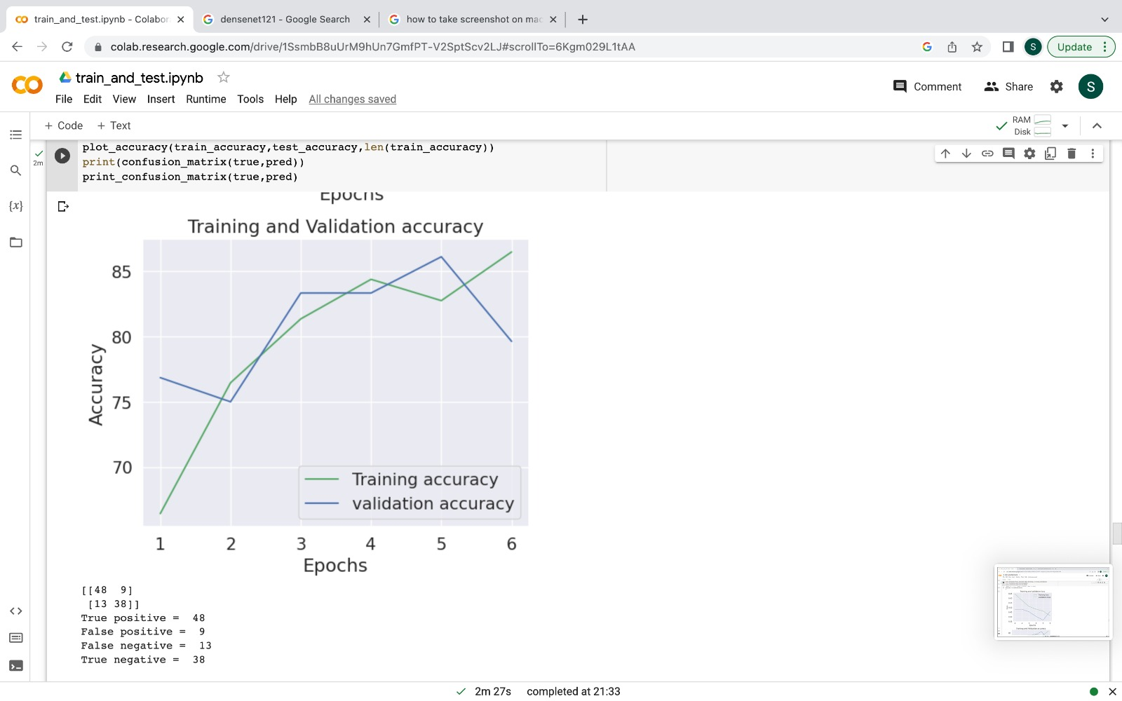
Graphs (ResNext)

Slide 14
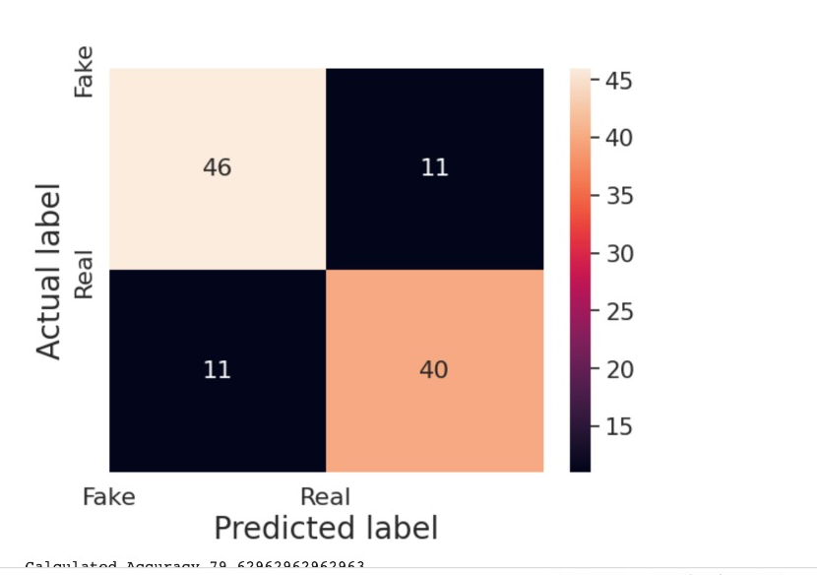
VGG 16

Slide 15
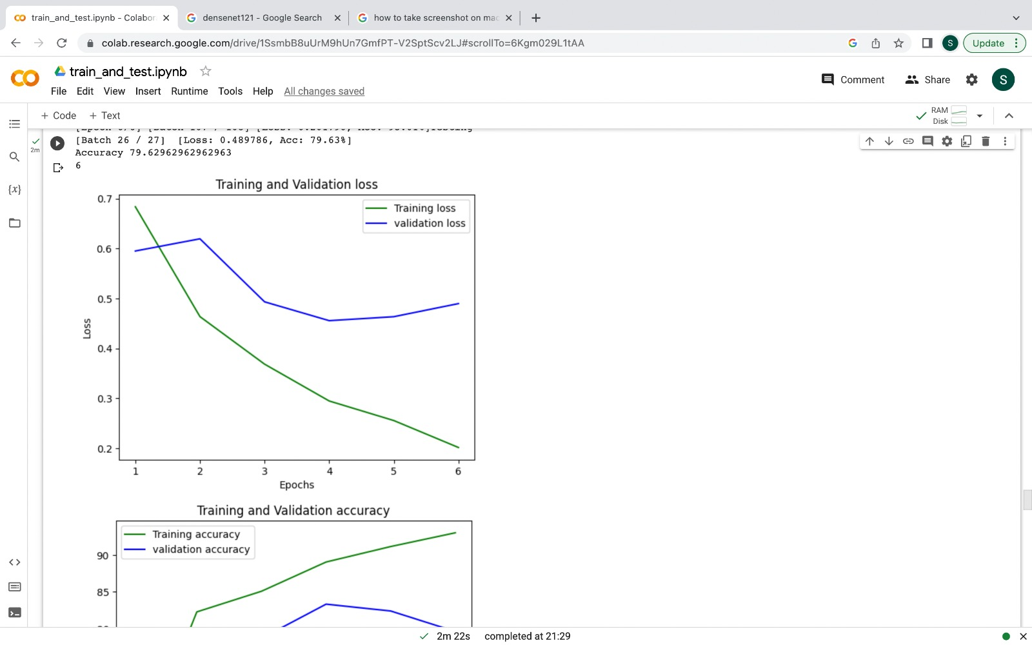
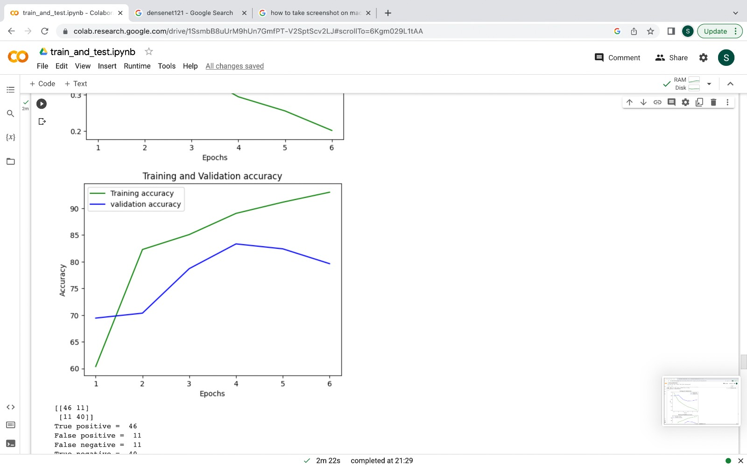
Graphs (VGG16)

Slide 16
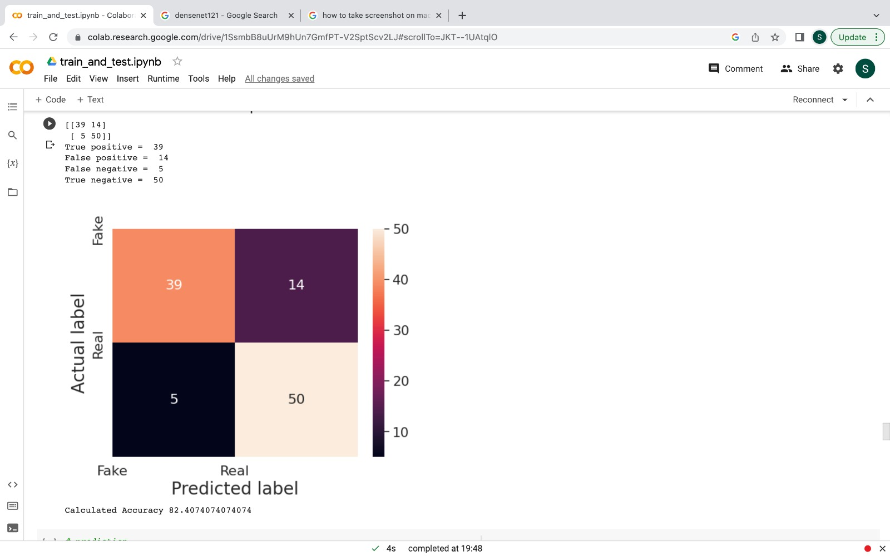
DenseNet

Slide 17
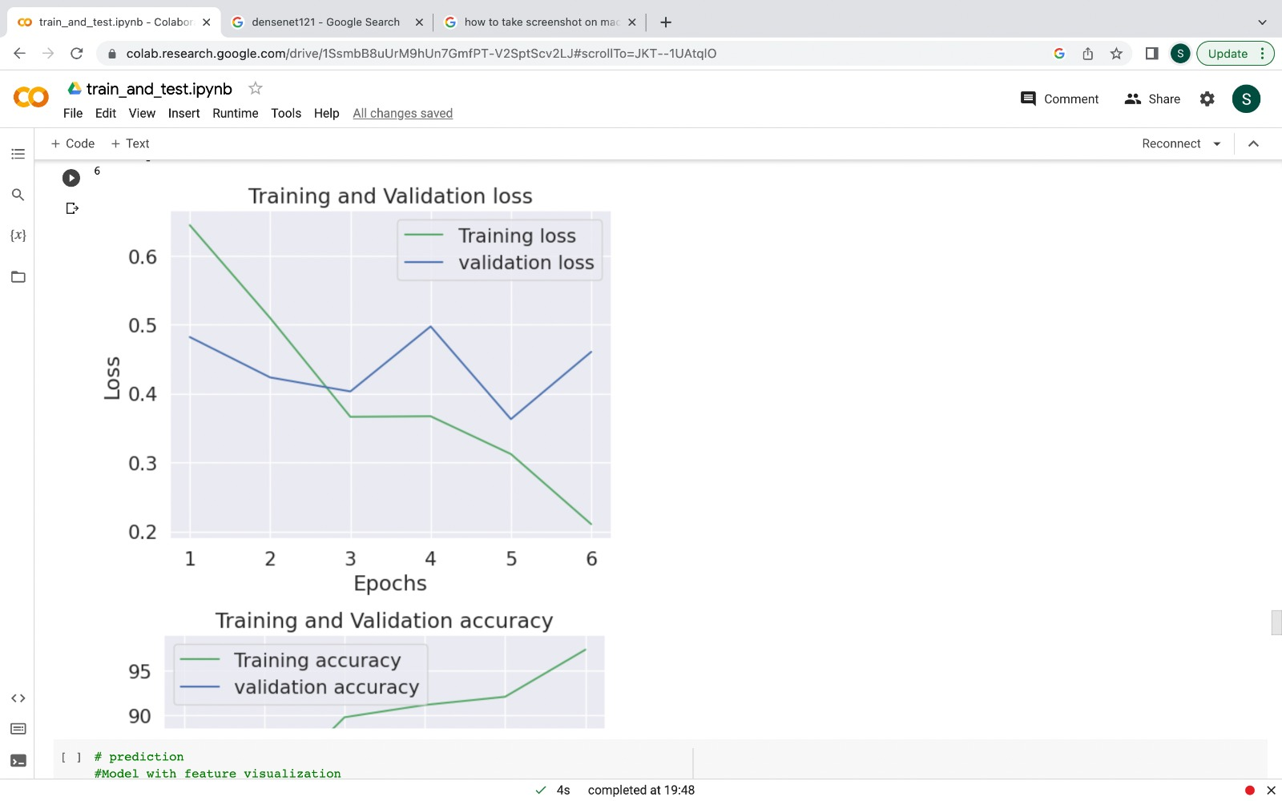
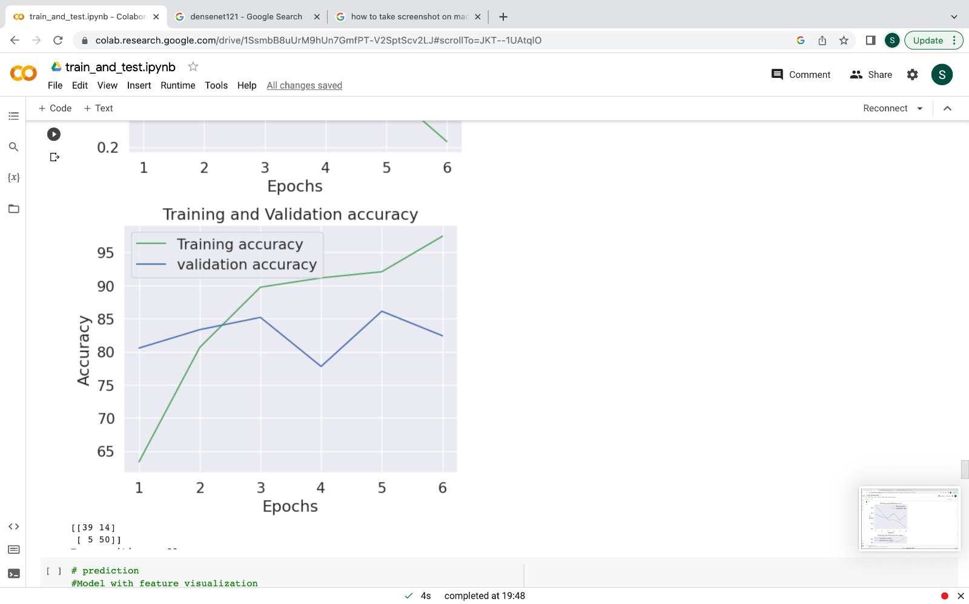
Graphs (DenseNet)

Slide 18














Programming Languages
Python3
JavaScript
Programming Frameworks
ReactJS
Django
Tools and Technologies
IDE
Jupyter Notebook
Visual Studio Code
Cloud Services
Google Cloud Platform
Version Control
Git

Slide 19
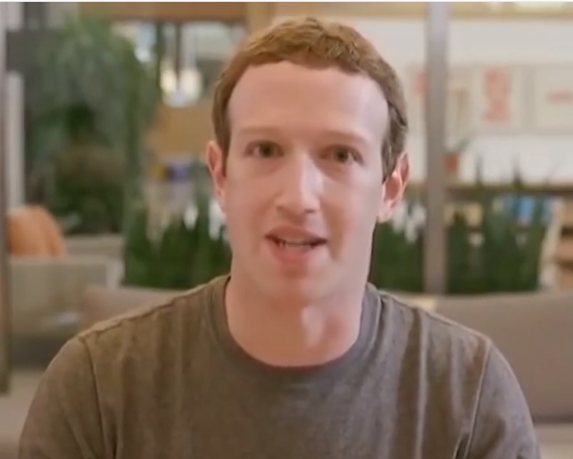
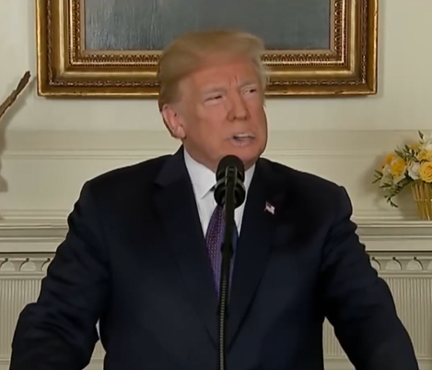
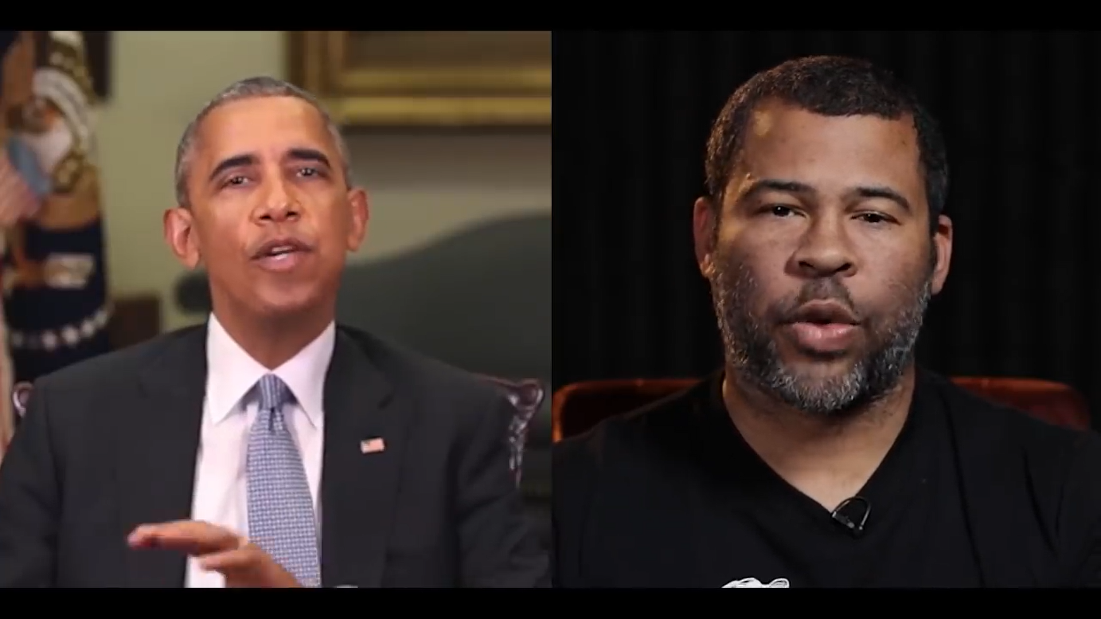
APPLICATIONS
Fake News
Malicious hoaxes
Celebrity unusual video
Revenge porn
Politician videos
WhatsApp Content

Slide 20


